Slide 1
Machine Learning Methods and Tools

Slide 2
Training Neural Networks
Elena Zennaro, Wolfgang Ecker, Lorenzo Servadei

Slide 3
Agenda: Training Neural Networks
Activation Functions
Data Preprocessing
Weight Initialization
Batch Normalization
Babysitting the Learning process
Hyperparameter Optimization
The „Deep“ Learning
Fei-Fei Li & Justin Johnson & Serena Yeung Lecture 6 - April 20, 2017

Slide 4
Activation Functions
Fei-Fei Li & Justin Johnson & Serena Yeung Lecture 6 - April 20, 2017

Slide 5
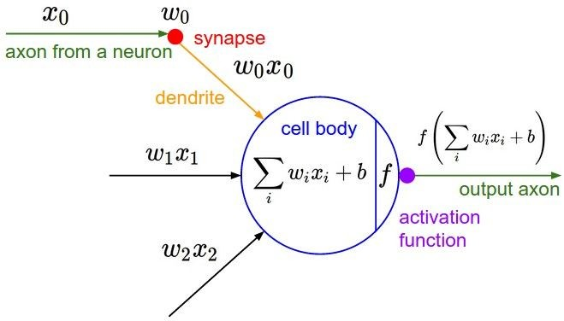
Activation Functions
Fei-Fei Li & Justin Johnson & Serena Yeung Lecture 6 - April 20, 2017

Slide 6
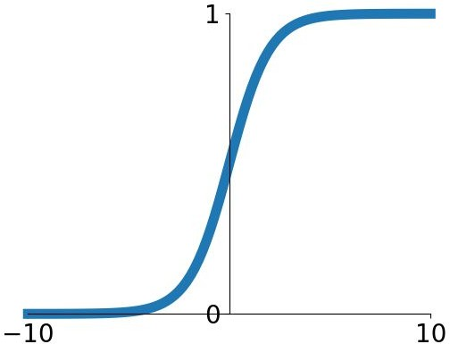
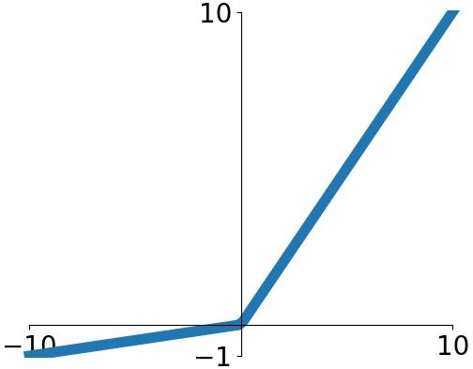
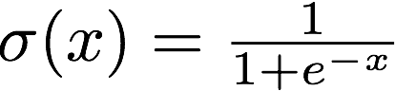
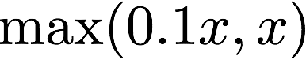
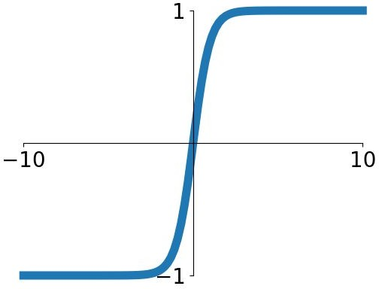
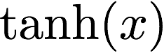
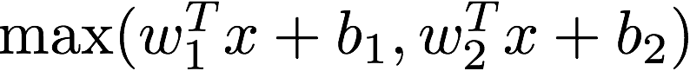
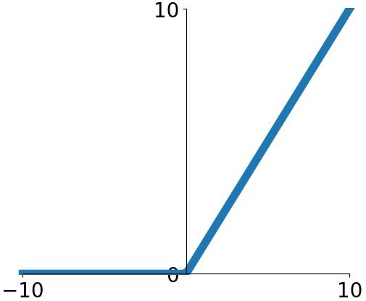
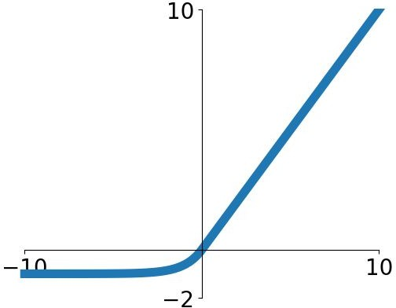
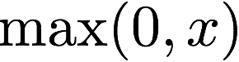
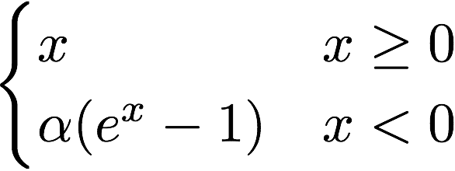
Activation Functions
Sigmoid
tanh
Leaky ReLU
Maxout
ReLU
ELU
Fei-Fei Li & Justin Johnson & Serena Yeung Lecture 6 - April 20, 2017

Slide 7
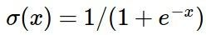
Activation Functions
Squashes numbers to range [0,1]
Historically popular since they have nice interpretation as a saturating “firing rate” of a neuron
Sigmoid
Fei-Fei Li & Justin Johnson & Serena Yeung Lecture 6 - April 20, 2017

Slide 8
Activation Functions
Squashes numbers to range [0,1]
Historically popular since they have nice interpretation as a saturating “firing rate” of a neuron
3 problems:
Sigmoid
1. Saturated neurons “kill” the gradients
Fei-Fei Li & Justin Johnson & Serena Yeung Lecture 6 - April 20, 2017

Slide 9
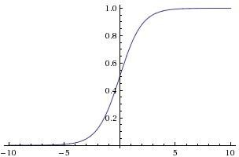
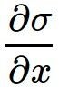
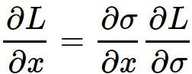
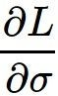
sigmoid gate
x
What happens when x = -10? What happens when x = 0?
What happens when x = 10?
Fei-Fei Li & Justin Johnson & Serena Yeung Lecture 6 - April 20, 2017

Slide 10
Activation Functions
Squashes numbers to range [0,1]
Historically popular since they have nice interpretation as a saturating “firing rate” of a neuron
3 problems:
Sigmoid
Saturated neurons “kill” the gradients
Sigmoid outputs are not zero-centered
Fei-Fei Li & Justin Johnson & Serena Yeung Lecture 6 - April 20, 2017

Slide 11
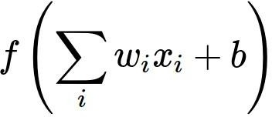
Consider what happens when the input to a neuron (x) is always positive:
What can we say about the gradients on w?
Fei-Fei Li & Justin Johnson & Serena Yeung Lecture 6 - April 20, 2017

Slide 12

Consider what happens when the input to a neuron is
always positive...
allowed gradient update directions
allowed gradient update directions
zig zag path
hypothetical optimal w vector
What can we say about the gradients on w? Always all positive or all negative :(
(this is also why you want zero-mean data!)
Fei-Fei Li & Justin Johnson & Serena Yeung Lecture 6 - April 20, 2017

Slide 13
Activation Functions
Squashes numbers to range [0,1]
Historically popular since they have nice interpretation as a saturating “firing rate” of a neuron
3 problems:
Sigmoid
Saturated neurons “kill” the gradients
Sigmoid outputs are not zero-centered
exp() is a bit compute expensive

Slide 14
Activation Functions
Squashes numbers to range [-1,1]
zero centered (nice)
still kills gradients when saturated :(
tanh(x)
[LeCun et al., 1991]
Fei-Fei Li & Justin Johnson & Serena Yeung Lecture 6 - April 20, 2017

Slide 15
- Computes f(x) = max(0,x)
Activation Functions
Does not saturate (in + region)
Very computationally efficient
Converges much faster than sigmoid/tanh in practice (e.g. 6x)
Actually more biologically plausible than sigmoid
ReLU
(Rectified Linear Unit)
[Krizhevsky et al., 2012]
Fei-Fei Li & Justin Johnson & Serena Yeung Lecture 6 - April 20, 2017

Slide 16
- Computes f(x) = max(0,x)
Activation Functions
Does not saturate (in +region)
Very computationally efficient
Converges much faster than sigmoid/tanh in practice (e.g. 6x)
Actually more biologically plausible than sigmoid
Not zero-centered output
An annoyance:
hint: what is the gradient when x < 0?
ReLU
(Rectified Linear Unit)
Fei-Fei Li & Justin Johnson & Serena Yeung Lecture 6 - April 20, 2017

Slide 17
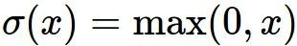
x
ReLU
gate
What happens when x = -10? What happens when x = 0?
What happens when x = 10?
Fei-Fei Li & Justin Johnson & Serena Yeung Lecture 6 - April 20, 2017

Slide 18


active ReLU
DATA CLOUD
dead ReLU
will never activate
=> never update
Fei-Fei Li & Justin Johnson & Serena Yeung Lecture 6 - April 20, 2017

Slide 19
active ReLU
DATA CLOUD
=> people like to initialize ReLU neurons with slightly positive biases (e.g. 0.01)
dead ReLU
will never activate
=> never update
Fei-Fei Li & Justin Johnson & Serena Yeung Lecture 6 - April 20, 2017

Slide 20
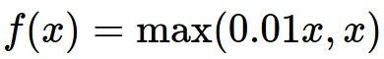
Activation Functions
[Mass et al., 2013] [He et al., 2015]
Does not saturate
Computationally efficient
Converges much faster than sigmoid/tanh in practice! (e.g. 6x)
- will not “die”.
Leaky ReLU
Fei-Fei Li & Justin Johnson & Serena Yeung Lecture 6 - April 20, 2017

Slide 21
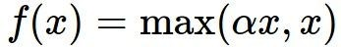
Activation Functions
[Mass et al., 2013] [He et al., 2015]
Does not saturate
Computationally efficient
Converges much faster than sigmoid/tanh in practice! (e.g. 6x)
- will not “die”.
Parametric Rectifier (PReLU)
Leaky ReLU
backprop into \alpha (parameter)
Fei-Fei Li & Justin Johnson & Serena Yeung Lecture 6 - April 20, 2017

Slide 22
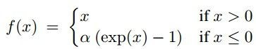
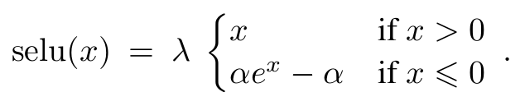
Activation Functions
[Clevert et al., 2015]
Exponential Linear Units (ELU)
- All benefits of ReLU
Closer to zero mean outputs
Negative saturation regime compared with Leaky ReLU adds some robustness to noise
Computation requires exp()
Scaled Exponential Linear Units (SELU)
Fei-Fei Li & Justin Johnson & Serena Yeung Lecture 6 - April 20, 2017

Slide 23
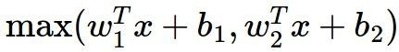
Maxout “Neuron”
[Goodfellow et al., 2013]
Does not have the basic form of dot product -> nonlinearity
Generalizes ReLU and Leaky ReLU
Linear Regime! Does not saturate! Does not die!
Problem: doubles the number of parameters/neuron :(
Fei-Fei Li & Justin Johnson & Serena Yeung Lecture 6 - April 20, 2017

Slide 24
TLDR: In practice:
Use ReLU. Be careful with your learning rates
Try out Leaky ReLU / Maxout / ELU / SELU
Try out tanh but don’t expect much (in CV)
Don’t use sigmoid (Within inner Layers of the network)
Fei-Fei Li & Justin Johnson & Serena Yeung Lecture 6 - April 20, 2017

Slide 25
Agenda: Training Neural Networks
Activation Functions
Data Preprocessing
Weight Initialization
Batch Normalization
Babysitting the Learning process
Hyperparameter Optimization
The „Deep“ Learning
Fei-Fei Li & Justin Johnson & Serena Yeung Lecture 6 - April 20, 2017

Slide 26
Data Preprocessing
Fei-Fei Li & Justin Johnson & Serena Yeung Lecture 6 - April 20, 2017

Slide 27
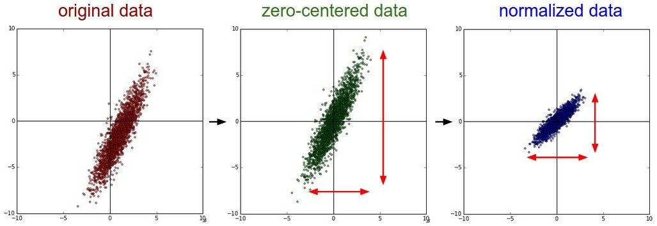
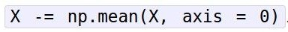
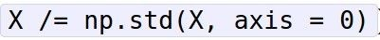
Step 1: Preprocess the data
(Assume X [NxD] is data matrix, each example in a row)
Fei-Fei Li & Justin Johnson & Serena Yeung Lecture 6 - April 20, 2017

Slide 28
Remember: Consider what happens when the input to a
neuron is always positive...
allowed gradient update directions
allowed gradient update directions
zig zag path
hypothetical optimal w vector
What can we say about the gradients on w? Always all positive or all negative :(
(this is also why you want zero-mean data!)
Fei-Fei Li & Justin Johnson & Serena Yeung Lecture 6 - April 20, 2017

Slide 29
Step 1: Preprocess the data
(Assume X [NxD] is data matrix,
each example in a row)
Fei-Fei Li & Justin Johnson & Serena Yeung
Fei-Fei Li & Justin Johnson & Serena Yeung Lecture 6 - April 20, 2017

Slide 30
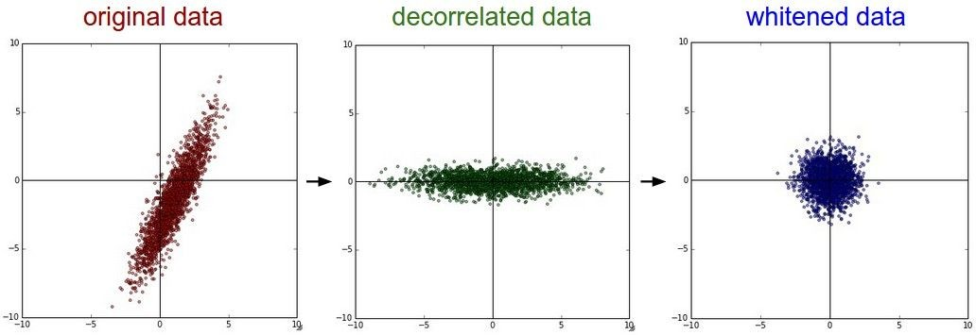
Step 1: Preprocess the data
In practice, you may also see PCA and Whitening of the data
(data has diagonal covariance matrix)
(covariance matrix is the identity matrix)
Lecture 6 - 38
Fei-Fei Li & Justin Johnson & Serena Yeung Lecture 6 - April 20, 2017

Slide 31
TLDR: In practice for Images: center only
e.g. consider CIFAR-10 example with [32,32,3] images
Subtract the mean image (e.g. AlexNet) (mean image = [32,32,3] array)
Subtract per-channel mean (e.g. VGGNet) (mean along each channel = 3 numbers)
Not common to normalize variance, to do PCA or whitening
Fei-Fei Li & Justin Johnson & Serena Yeung Lecture 6 - April 20, 2017

Slide 32
Agenda: Training Neural Networks
Activation Functions
Data Preprocessing
Weight Initialization
Batch Normalization
Babysitting the Learning process
Hyperparameter Optimization
The „Deep“ Learning
Fei-Fei Li & Justin Johnson & Serena Yeung Lecture 6 - April 20, 2017

Slide 33
Weight Initialization
Fei-Fei Li & Justin Johnson & Serena Yeung Lecture 6 - April 20, 2017

Slide 34
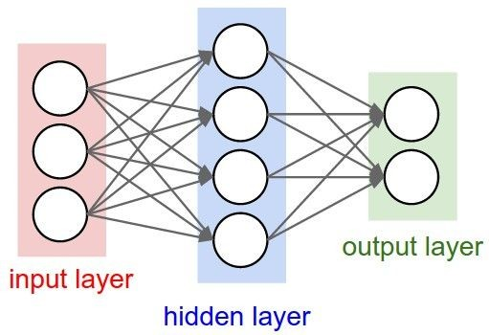
- Q: what happens when W=0 init is used?
Fei-Fei Li & Justin Johnson & Serena Yeung Lecture 6 - April 20, 2017

Slide 35
- First idea: Small random numbers
(gaussian with zero mean and 1e-2 standard deviation)
Fei-Fei Li & Justin Johnson & Serena Yeung Lecture 6 - April 20, 2017

Slide 36
- First idea: Small random numbers
(gaussian with zero mean and 1e-2 standard deviation)
Works ~okay for small networks, but problems with deeper networks.
Fei-Fei Li & Justin Johnson & Serena Yeung Lecture 6 - April 20, 2017

Slide 37
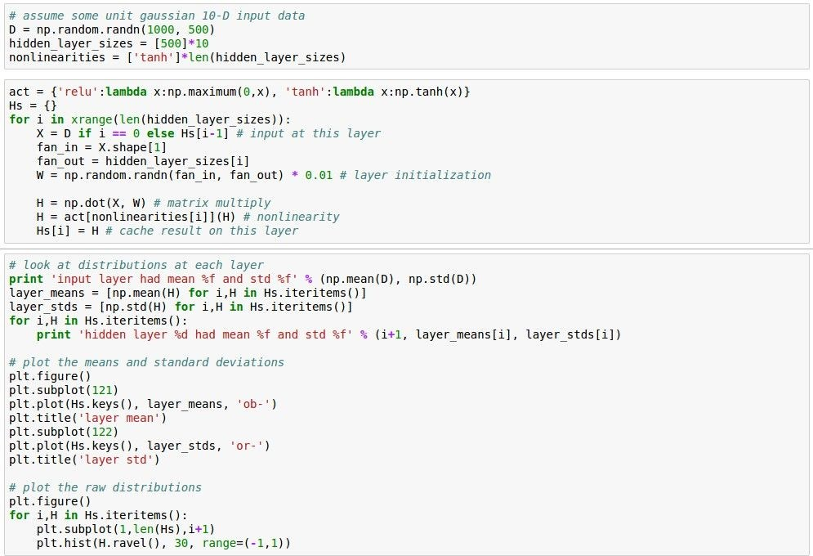
Lets look at some activation statistics
E.g. 10-layer net with 500 neurons on each layer, using tanh
non-linearities, and initializing as described in last slide.

Slide 38
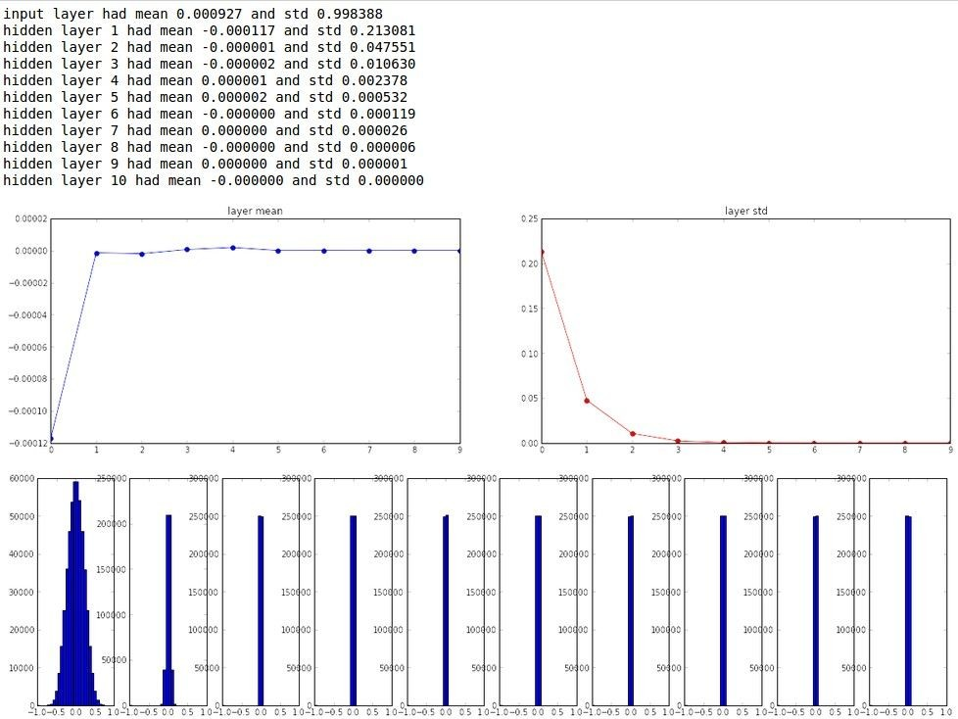

Slide 39
All activations become zero!
Q: think about the backward pass.
What do the gradients look like?
Hint: think about backward pass for a W*X gate.
Fei-Fei Li & Justin Johnson & Serena Yeung Lecture 6 - April 20, 2017

Slide 40
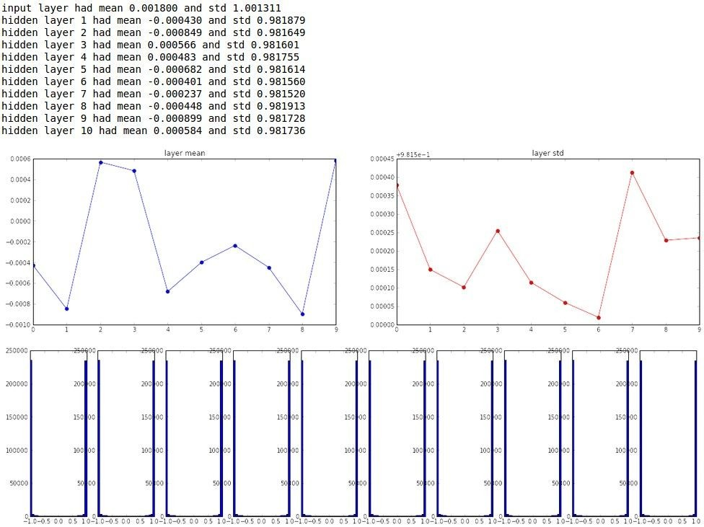
Almost all neurons completely saturated, either -1
and 1. Gradients will be all zero.
*1.0 instead of *0.01
Fei-Fei Li & Justin Johnson & Serena Yeung Lecture 6 - April 20, 2017

Slide 41
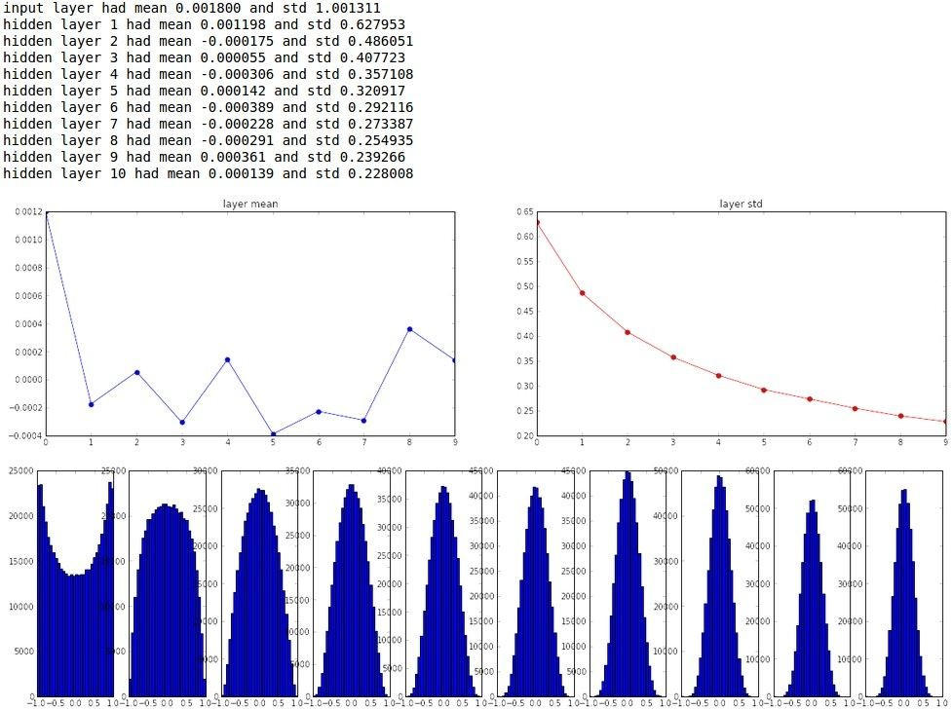
“Xavier initialization” [Glorot et al., 2010]
Reasonable initialization. (Mathematical derivation aside)
Fei-Fei Li & Justin Johnson & Serena Yeung Lecture 6 - April 20, 2017

Slide 42
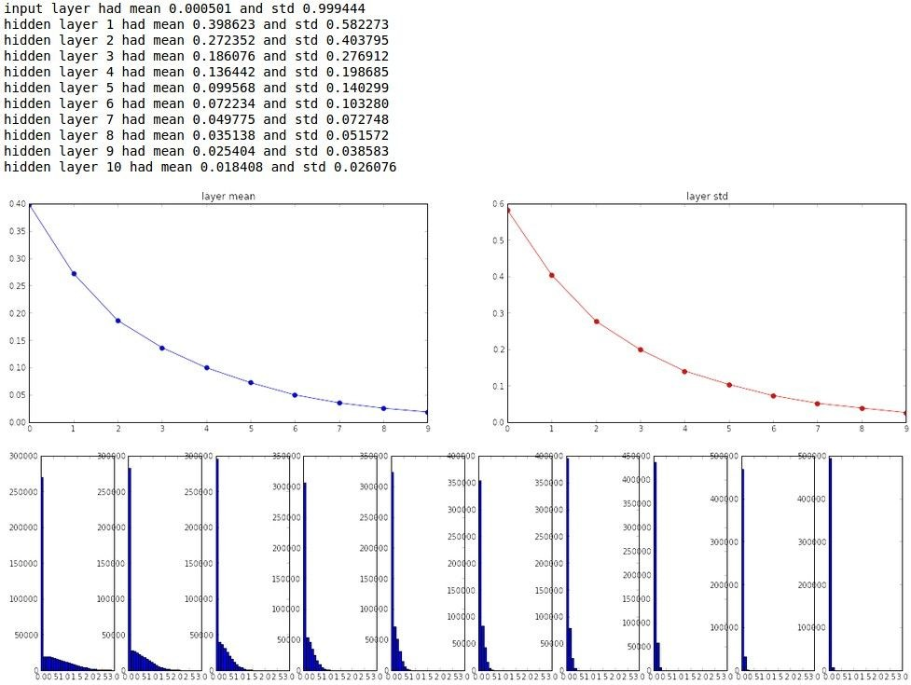
but when using the ReLU nonlinearity it breaks.
Fei-Fei Li & Justin Johnson & Serena Yeung Lecture 6 - April 20, 2017

Slide 43
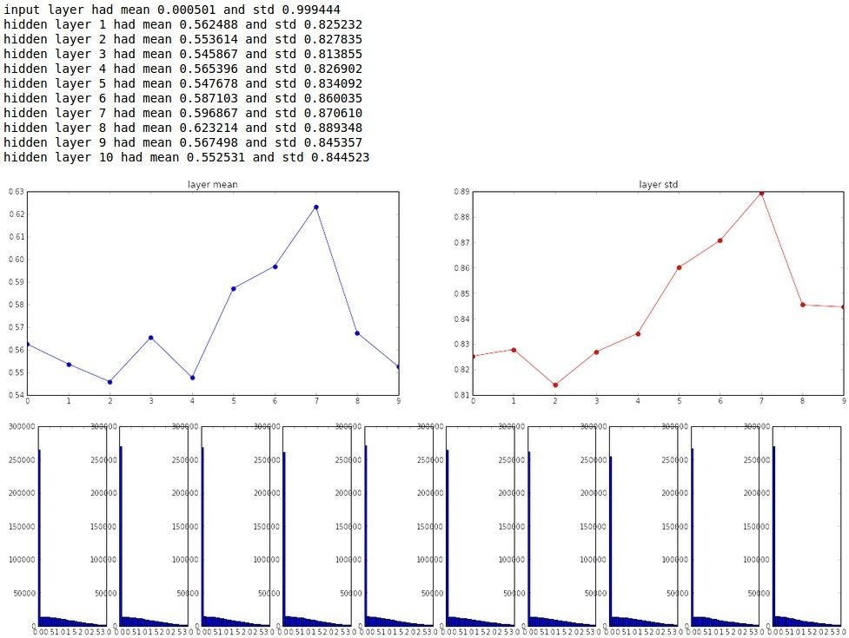
He et al., 2015 (note additional /2)
Fei-Fei Li & Justin Johnson & Serena Yeung Lecture 6 - April 20, 2017

Slide 44
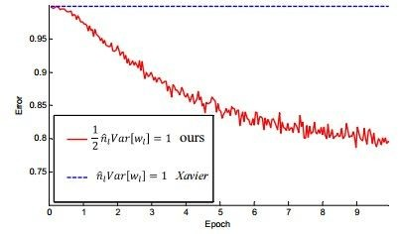
He et al., 2015 (note additional /2)
Fei-Fei Li & Justin Johnson & Serena Yeung Lecture 6 - April 20, 2017

Slide 45
Proper initialization is an active area of research…
Understanding the difficulty of training deep feedforward neural networks
by Glorot and Bengio, 2010
Exact solutions to the nonlinear dynamics of learning in deep linear neural networks by Saxe et al, 2013
Random walk initialization for training very deep feedforward networks by Sussillo and Abbott, 2014
Delving deep into rectifiers: Surpassing human-level performance on ImageNet classification by He et al., 2015
Data-dependent Initializations of Convolutional Neural Networks by Krähenbühl et al., 2015
All you need is a good init, Mishkin and Matas, 2015
…
Fei-Fei Li & Justin Johnson & Serena Yeung Lecture 6 - April 20, 2017

Slide 46
Agenda: Training Neural Networks
Activation Functions
Data Preprocessing
Weight Initialization
Batch Normalization
Babysitting the Learning process
Hyperparameter Optimization
The „Deep“ Learning
Fei-Fei Li & Justin Johnson & Serena Yeung Lecture 6 - April 20, 2017

Slide 47
Batch Normalization
Fei-Fei Li & Justin Johnson & Serena Yeung Lecture 6 - April 20, 2017

Slide 48
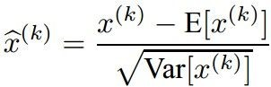
Batch Normalization
[Ioffe and Szegedy, 2015]
“you want unit gaussian activations? just make them so.”
consider a batch of activations at some layer. To make each dimension unit gaussian, apply:
this is a vanilla differentiable function...
Fei-Fei Li & Justin Johnson & Serena Yeung Lecture 6 - April 20, 2017

Slide 49


Batch Normalization
[Ioffe and Szegedy, 2015]
“you want unit gaussian activations? just make them so.”
X
1. compute the empirical mean and variance independently for each dimension.
N
2. Normalize
D
Fei-Fei Li & Justin Johnson & Serena Yeung Lecture 6 - April 20, 2017

Slide 50
Batch Normalization
[Ioffe and Szegedy, 2015]
FC
Usually inserted after Fully Connected or Convolutional layers, and before nonlinearity.
BN
tanh
FC
BN
tanh
...
Fei-Fei Li & Justin Johnson & Serena Yeung Lecture 6 - April 20, 2017

Slide 51
Batch Normalization
[Ioffe and Szegedy, 2015]
FC
Usually inserted after Fully Connected or Convolutional layers, and before nonlinearity.
BN
tanh
FC
BN
Problem: do we necessarily want a unit gaussian input to a tanh layer?
tanh
...
Fei-Fei Li & Justin Johnson & Serena Yeung Lecture 6 - April 20, 2017

Slide 52
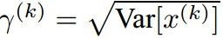
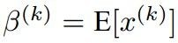
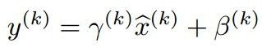
Batch Normalization
[Ioffe and Szegedy, 2015]
Normalize:
Note, the network can learn:
to recover the identity mapping.
And then allow the network to squash the range if it wants to:
Fei-Fei Li & Justin Johnson & Serena Yeung Lecture 6 - April 20, 2017

Slide 53
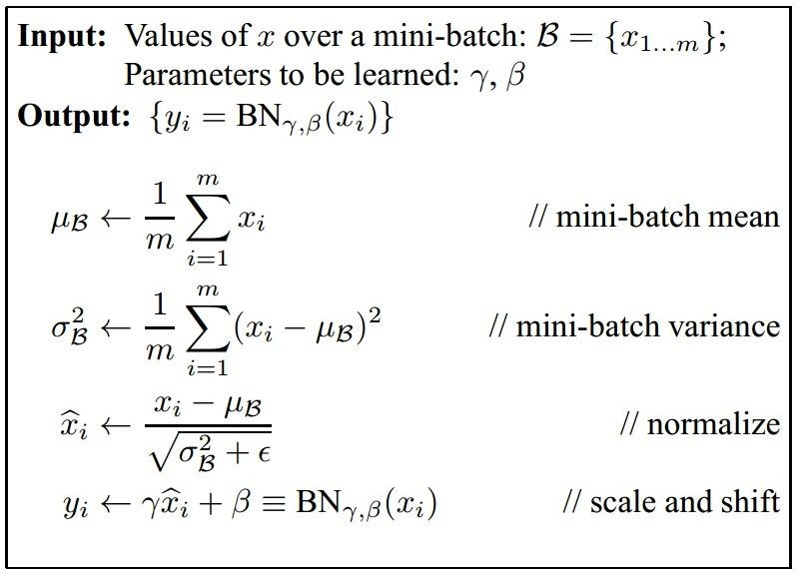
Batch Normalization
[Ioffe and Szegedy, 2015]
Improves gradient flow through the network
Allows higher learning rates
Reduces the strong dependence on initialization
Acts as a form of regularization in a funny way, and slightly reduces the need for dropout, maybe
Fei-Fei Li & Justin Johnson & Serena Yeung Lecture 6 - April 20, 2017

Slide 54
Batch Normalization
[Ioffe and Szegedy, 2015]
Note: at test time BatchNorm layer functions differently:
The mean/std are not computed based on the batch. Instead, a single fixed empirical mean of activations during training is used.
(e.g. can be estimated during training with running averages)
Fei-Fei Li & Justin Johnson & Serena Yeung Lecture 6 - April 20, 2017

Slide 55
Agenda: Training Neural Networks
Activation Functions
Data Preprocessing
Weight Initialization
Batch Normalization
Babysitting the Learning process
Hyperparameter Optimization
The „Deep“ Learning
Fei-Fei Li & Justin Johnson & Serena Yeung Lecture 6 - April 20, 2017

Slide 56
Babysitting the Learning Process
Fei-Fei Li & Justin Johnson & Serena Yeung Lecture 6 - April 20, 2017

Slide 57
Step 1: Preprocess the data
(Assume X [NxD] is data matrix, each example in a row)
Fei-Fei Li & Justin Johnson & Serena Yeung Lecture 6 - April 20, 2017

Slide 58
Step 2: Choose the architecture:
say we start with one hidden layer of 50 neurons:
50 hidden neurons
output layer
10 output neurons, one per class
CIFAR-10
images, 3072
numbers
input layer
hidden layer
Fei-Fei Li & Justin Johnson & Serena Yeung Lecture 6 - April 20, 2017

Slide 59
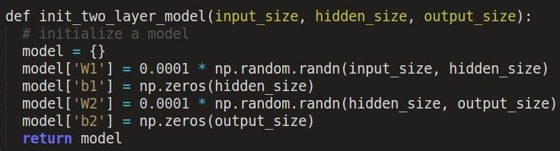
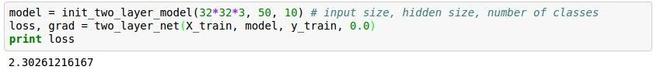
Double check that the loss is reasonable:
disable regularization
loss ~2.3. “correct “ for 10 classes
returns the loss and the gradient for all parameters
Fei-Fei Li & Justin Johnson & Serena Yeung Lecture 6 - April 20, 2017

Slide 60
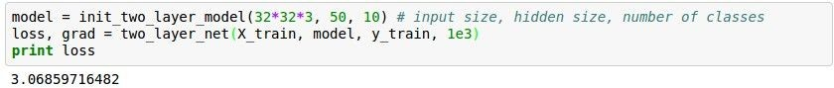
Double check that the loss is reasonable:
crank up regularization
loss went up, good. (sanity check)
Fei-Fei Li & Justin Johnson & Serena Yeung Lecture 6 - April 20, 2017

Slide 61
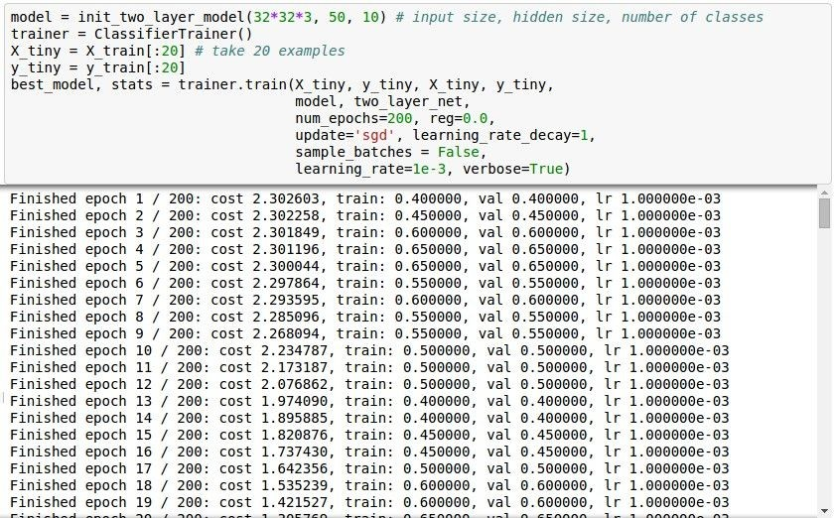
Lets try to train now…
Tip: Make sure that you can overfit very small portion of the training data
The above code:
take the first 20 examples from CIFAR-10
turn off regularization (reg = 0.0)
use simple vanilla ‘sgd’
Fei-Fei Li & Justin Johnson & Serena Yeung Lecture 6 - April 20, 2017

Slide 62
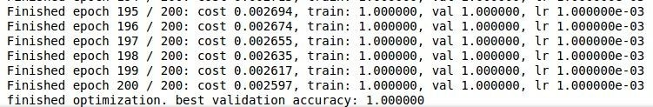

Lets try to train now…
Tip: Make sure that you can overfit very small portion of the training data
Very small loss, train accuracy 1.00, nice!
Fei-Fei Li & Justin Johnson & Serena Yeung Lecture 6 - April 20, 2017

Slide 63
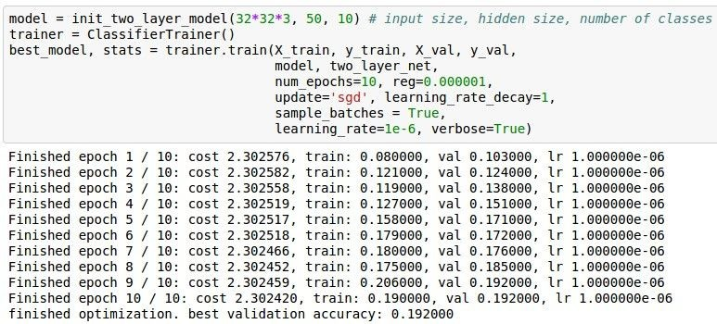
Lets try to train now…
Start with small regularization and find learning rate that makes the loss go down.
Fei-Fei Li & Justin Johnson & Serena Yeung Lecture 6 - April 20, 2017

Slide 64
Lets try to train now…
Start with small regularization and find learning rate that makes the loss go down.
Loss barely changing
Fei-Fei Li & Justin Johnson & Serena Yeung Lecture 6 - April 20, 2017

Slide 65
Lets try to train now…
Start with small regularization and find learning rate that makes the loss go down.
Loss barely changing: Learning rate is probably too low
loss not going down:
learning rate too low
Fei-Fei Li & Justin Johnson & Serena Yeung Lecture 6 - April 20, 2017

Slide 66
Lets try to train now…
Start with small regularization and find learning rate that makes the loss go down.
Loss barely changing: Learning rate is probably too low
loss not going down:
learning rate too low
Notice train/val accuracy goes to 20% though, what’s up with that? (remember this is softmax)
Fei-Fei Li & Justin Johnson & Serena Yeung Lecture 6 - April 20, 2017

Slide 67
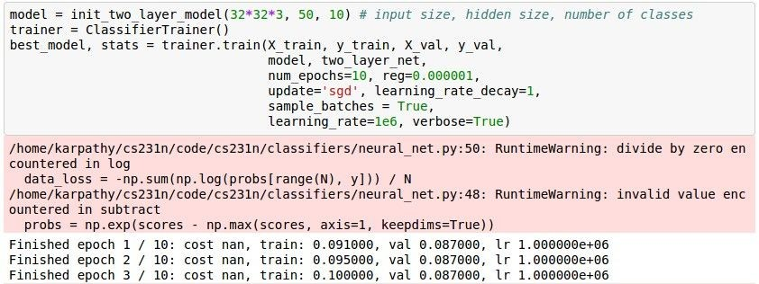
Lets try to train now…
Start with small regularization and find learning rate that makes the loss go down.
loss not going down:
learning rate too low
Now let’s try learning rate 1e6.
Fei-Fei Li & Justin Johnson & Serena Yeung Lecture 6 - April 20, 2017

Slide 68
Lets try to train now…
Start with small regularization and find learning rate that makes the loss go down.
cost: NaN almost always means high learning rate...
loss not going down: learning rate too low loss exploding: learning rate too high
Fei-Fei Li & Justin Johnson & Serena Yeung Lecture 6 - April 20, 2017

Slide 69
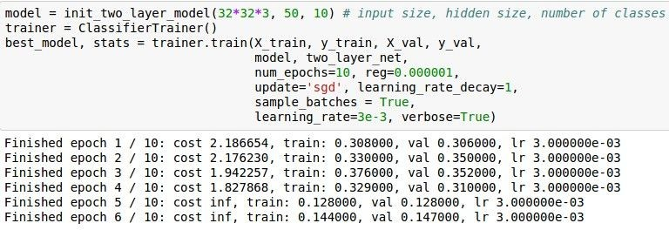
Lets try to train now…
Start with small regularization and find learning rate that makes the loss go down.
3e-3 is still too high. Cost explodes….
loss not going down: learning rate too low loss exploding: learning rate too high
=> Rough range for learning rate we should be cross-validating is somewhere [1e-3 … 1e-5]
Fei-Fei Li & Justin Johnson & Serena Yeung Lecture 6 - April 20, 2017

Slide 70
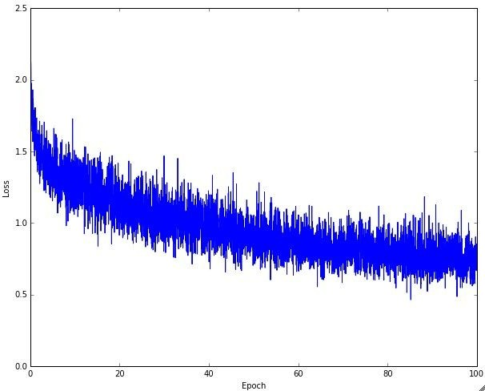

Monitor and visualize the loss curve
Fei-Fei Li & Justin Johnson & Serena Yeung Lecture 6 - April 20, 2017

Slide 71
Loss
time
Fei-Fei Li & Justin Johnson & Serena Yeung Lecture 6 - April 20, 2017

Slide 72
Bad initialization a prime suspect
Loss
time
Fei-Fei Li & Justin Johnson & Serena Yeung Lecture 6 - April 20, 2017

Slide 73

Monitor and visualize the accuracy:
big gap = overfitting
=> increase regularization strength?
no gap
=> increase model capacity?
Fei-Fei Li & Justin Johnson & Serena Yeung Lecture 6 - April 20, 2017

Slide 74

Track the ratio of weight updates / weight magnitudes:
ratio between the updates and values: ~ 0.0002 / 0.02 = 0.01 (about okay)
want this to be somewhere around 0.001 or so
Fei-Fei Li & Justin Johnson & Serena Yeung Lecture 6 - April 20, 2017

Slide 75
Agenda: Training Neural Networks
Activation Functions
Data Preprocessing
Weight Initialization
Batch Normalization
Babysitting the Learning process
Hyperparameter Optimization
The „Deep“ Learning
Fei-Fei Li & Justin Johnson & Serena Yeung Lecture 6 - April 20, 2017

Slide 76

Hyperparameter Optimization
Fei-Fei Li & Justin Johnson & Serena Yeung Lecture 6 - April 20, 2017

Slide 77
Cross-validation strategy
coarse -> fine cross-validation in stages
First stage: only a few epochs to get rough idea of what params work
Second stage: longer running time, finer search
… (repeat as necessary)
Tip for detecting explosions in the solver:
If the cost is ever > 3 * original cost, break out early
Fei-Fei Li & Justin Johnson & Serena Yeung Lecture 6 - April 20, 2017

Slide 78


For example: run coarse search for 5 epochs
note it’s best to optimize
in log space!
nice
Fei-Fei Li & Justin Johnson & Serena Yeung Lecture 6 - April 20, 2017

Slide 79


Now run finer search...
adjust range
53% - relatively good for a 2-layer neural net with 50 hidden neurons.
Fei-Fei Li & Justin Johnson & Serena Yeung Lecture 6 - April 20, 2017

Slide 80
Now run finer search...
adjust range
53% - relatively good for a 2-layer neural net with 50 hidden neurons.
But this best
cross-validation result is worrying. Why?
Fei-Fei Li & Justin Johnson & Serena Yeung Lecture 6 - April 20, 2017

Slide 81
Random Search for
Random Search vs. Grid Search
Hyper-Parameter Optimization
Bergstra and Bengio, 2012
Grid Layout Random Layout
Unimportant Parameter
Unimportant Parameter
Important Parameter
Important Parameter
Illustration of Bergstra et al., 2012 by Shayne Longpre, copyright CS231n 2017
Fei-Fei Li & Justin Johnson & Serena Yeung Lecture 6 - April 20, 2017

Slide 82
Bayesian Hyperparameters Optimization
Bayesian methods use past evaluation results to choose the next values.
Limit expensive evaluations of the objective function by choosing the next input values based on those that have done well in the past.

Slide 83
Bayesian Hyperparameters Optimization
Objective function is the validation error of a machine learning model using a set of hyperparameters
We want a method that can explore the search space while also limiting evaluations of poor hyperparameter choices.
Bayesian hyper parameter tuning uses a continually updated probability model to “concentrate” on promising hyperparameters by reasoning from past results.

Slide 84
Intuition
We want to find the peak of our true function (eg. accuracy as a function of hyperparameters)
To find this peak, we will fit a Gaussian Process to our observed points and pick our next best point where we believe the maximum will be.
This next point is determined by an acquisition function - that trades of exploration and exploitation

Slide 85

Multi-armed bandit problem
money!

Slide 86

Multi-armed bandit problem
Actions
Reward(s)
Sequence of trials
Trade-off between Exploration and Exploitation
Regret = Player reward – Reward of best action

Slide 87


















Slide 88

Acquisition
function
Parameter

Slide 89


Exploration-exploitation tradeoff
Recall the expressions for GP prediction:
We should choose the next point x where the mean is high
(exploitation) and the variance is high (exploration).
We could balance this tradeoff with an acquisition function as
follows:

Slide 90












Acquisition functions

Slide 91





















An acquisition function: Probability of Improvement

Slide 92


People as Bayesian reasoners

Slide 93






An expected utility criterion
At iteration n+1, choose the point that minimizes the distance to the objective evaluated at the maximum x*:
We don’t know the true objective at the maximum. To overcome this, Mockus proposed the following acquisition function:

Slide 94


Expected improvement
For this acquisition, we can obtain an analytical expression:

Slide 95
The Prior
Power of Gaussian Process depends on covariance function
For optimization, we don’t want kernels that produce unrealistically smooth sample functions
Automatic Relevance Determination (ARD) Matern 5/2 kernel is a good choice

Slide 96

Kernel Hyperparameters
Marginalize over hyperparameters and compute integrated acquisition function
Approximate integral with Monte Carlo methods

Slide 97
Considerations for Bayes Opt
- Evaluating f may be time-consuming
- Modern optimization methods should take advantage of multi-core/parallel programming

Slide 98

Logistic Regression - MNIST

Slide 99

CIFAR-10
3-layer conv-net
Optimized over
Number of epochs
Learning rate
L2-norm constants
Achieved state of the art
9.5% test error

Slide 100
GP Bayesian Optimization - Pros and Cons
Advantages
Computes the mean and variance
Disadvantages
Function evaluation is cubic on the number of inputs

Slide 101

Hyperparameters to play with:
- network architecture
learning rate, its decay schedule, update type
regularization (L2/Dropout strength)
neural networks practitioner music = loss function
This image by Paolo Guereta is licensed under CC-BY 2.0
Fei-Fei Li & Justin Johnson & Serena Yeung Lecture 6 - April 20, 2017

Slide 102

Cross-validation “command center”
Fei-Fei Li & Justin Johnson & Serena Yeung Lecture 6 - April 20, 2017

Slide 103
Agenda: Training Neural Networks
Activation Functions
Data Preprocessing
Weight Initialization
Batch Normalization
Babysitting the Learning process
Hyperparameter Optimization
The „Deep“ Learning
Fei-Fei Li & Justin Johnson & Serena Yeung Lecture 6 - April 20, 2017

Slide 104
To be continued...
Deep Neural Network – why do the they generalize?

Slide 105
Markov Chain
- A Markov process is a “memoryless” (also called “Markov Property”) stochastic process.
A Markov chain is a type of Markov process containing multiple discrete states.
The conditional probability of future states of the process is only determined by the current state and does not depend on the past states.

Slide 106

Kullback - Leibler Divergence
Kullback – Leibler (KL) Divergence measures how one probability distribution p diverges from a second expected probability distribution q. It is asymmetric.

Slide 107

Mutual Information
Mutual information measures the mutual dependence between two variables.
It quantifies the “amount of information” obtained about one random variable through the other random variable. Mutual information is symmetric.

Slide 108
Data Processing Inequality (DPI)
For any markov chain: X→Y→Z, we would have
I(X;Y) ≥ I(X;Z).
A deep neural network can be viewed as a Markov chain, and thus when we are moving down the layers of a DNN, the mutual information between the layer and the input can only decrease.

Slide 109
Reparametrization invariance
For two invertible functions ϕ, ψ, the mutual information still holds: I(X;Y)=I(ϕ(X);ψ(Y)).
For example, if we shuffle the weights in one layer of DNN, it would not affect the mutual information between this layer and another.

Slide 110


Deep Neural Networks as Markov chain
A DNN is designed to learn how to describe X to predict Y and eventually, to compress X to only hold the information related to Y.

Slide 111
Information Plane Theorem
A DNN has successive internal representations of X, a set of hidden layers {Ti}.
The information plane theorem characterizes each layer by its encoder and decoder information.
The encoder is a representation of the input data X, while the decoder translates the information in the current layer to the target ouput

Slide 112
Information Plane Theorem
X-axis: The sample complexity of Ti is determined by the encoder mutual information I(X; Ti). Sample complexity refers to how many samples you need to achieve certain accuracy and generalization.
Y-axis: The accuracy (generalization error) is determined by the decoder mutual information I(Ti;Y).

Slide 113

Information Plane Theorem

Slide 114

Information Plane Theorem
The encoder vs decoder mutual information of DNN hidden layers of 50 experiments.
Different layers are color-coders, with green being the layer right next to the input
and the orange being the furthest.
There are three snapshots, at the initial epoch, 400 epochs and 9000 epochs respectively.

Slide 115

Two Optimization Phases

Slide 116


Old generalization Bound
$ε$: The difference between the training error and the generalization error. The generalization error measures how accurate the prediction of an algorithm is for previously unseen data.
$H_{ε}$: $ε$- cover of the hypothesis class. Typically we assume the size $\left|H_{ε}\right|∼{\left(1 \backslash ε\right)}^{d}$.
$δ$: Confidence.
m: The number of training samples.
d: The VC dimension of the hypothesis.

Slide 117

Comparing

Slide 118



New Input Compression Bound
When X is large, the size of X is approximately $2^{\left|H(X)\right|}$.
Each cell in the $ε$-partition is of size $2^{\left|H(X|T_{ε})\right|}$. Therefore we have .Then the input compression bound becomes:

Slide 119


New Input Compression Bound
First let us have $T_{ε}$as an $ε$-partition of the input variable X.
This partition compresses the input with respect to the homogeneity to the labels into small cells.
The cells in total can cover the whole input space.
If the prediction outputs binary values, we can replace the cardinality of the hypothesis, $|H_{ε}|$, with $2^{|T_{ε}|}$

Slide 120
Sources
http://cs231n.stanford.edu/2017/syllabus.html
https://www.cs.ubc.ca/~nando/540-2013/lectures.html
https://www.youtube.com/watch?v=bLqJHjXihK8&feature=youtu.be&t=15m15s

